Slide 1
Productivity Prediction of Garment Employees

Slide 2
Description of the dataset
The Garment Industry is one example of the industrial globalization of the modern era. Characterized by its labor-intensive nature and dependency on manual processes, the industry’s success depends on the efficiency and performance of its employees. This dataset provides key attributes that will give us insight into employee productivity and performance within the company.
Source: Productivity Prediction of Garment Employees - UCI Machine Learning Repository

Slide 3
Description of the dataset – Data type
Date : This column is the specific date of each entry, and it is considered as date type.
Day : This data is a categorical data type, and it is the day of the Week.
Quarter : This column is a portion of the month. A month was divided into four quarters. This data type is a string.
Department : This data is a string and is describing an associated department within the company.
Team_no : This is referring to the associated team number with the company. This column is an integer.
No_of_workers : This column is an integer and is the number of workers in each team.
No_of_style_change : Number of changes in the style of a particular product. This data type is an integer.
Targeted_productivity : Targeted productivity set by the team’s supervisor for each day. This is an integer.

Slide 4
Description of the dataset – Data type (cont.)
SMV : This column is a float data type, and it is referring to the standard Minute Value, it is the allocated time for a task.
WIP : Work in progress. Includes the number of unfinished items for products. This data type is an integer.
Over_time : Represents the amount of overtime by each team in minutes. This is an integer
Incentive : Represents the amount of financial incentive (in BDT) that enables or motivates a particular course of action. This is a float.
Idle_time : The amount of time when the production was interrupted due to several reasons. This is an integer.
Idle_men : The number of workers who were idle due to production interruption. This is an integer.
Actual_productivity : The actual % of productivity that was delivered by the workers. It ranges from 0-1. This is a float.

Slide 5
Problem statement
The Garment industry is facing challenges in maintaining high productivity and performance levels. The company is focused on identifying the key factors contributing to low productivity within the garment manufacturing teams and exploring effective strategies to address these issues. By analyzing this data, the company hopes to gain insights that will inform future strategies and business decisions to optimize performance and enhance operational efficiency.

Slide 6
MLS Flowchart
Data Extraction
Target:
- Actual productivity
Data Collection:
Data from Productivity Prediction of Garment Employees.
Data Preparation
Run the predictive model one hour before the start of a shift and one hour before the end of each shift.
SQL table
Data Processing
Model Training
Features:
- Department
- Team number
- Number of workers
- Number of style change
- Standard minute value
- Overtime
- Idle time
- Idle men
- Targeted productivity
Deployment
Monitor & Maintenance
Data Transformation
Maintenance once a week. If failure appears contact data engineering department.
Data Output

Slide 7
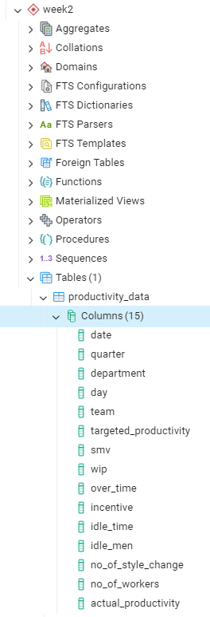
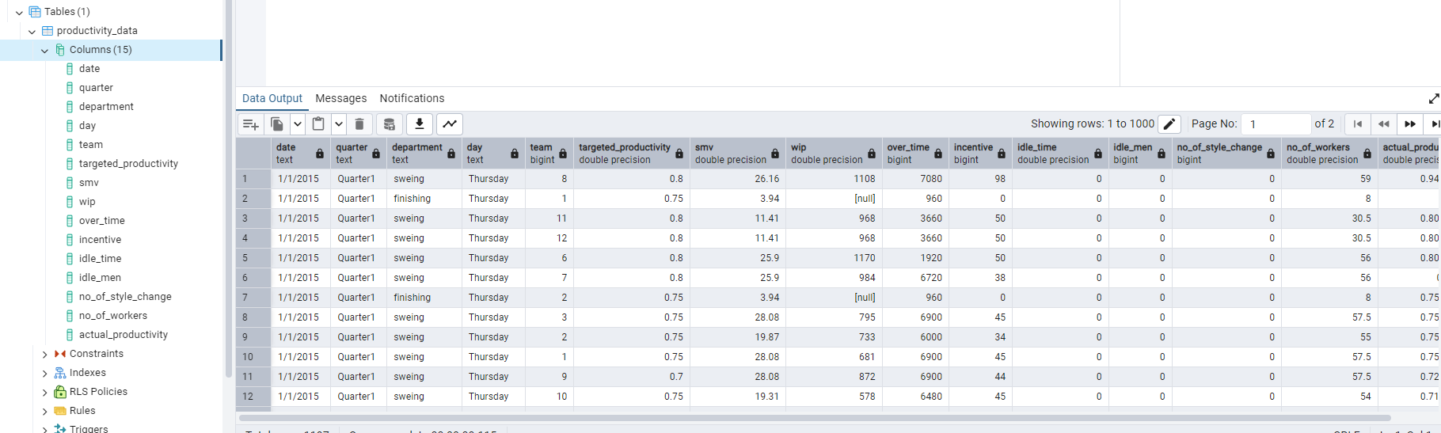
Loaded data in pgAdmin

